Slide 1


HEFCE Review of Museums, Galleries and Collections Fund
Cinema, Imperial War Museums, Lambeth Road, London
30 June 2016 1000 - 1300

Slide 2
Aims of the review
  2010 review
  funding for individual HE museums, galleries and collections (HEMG) agreed by HEFCE Board in May 2010
  2016 review
  to ensure that judgements on HEMG funding continue to be based on clear principles and evidence
  submissions assessed within their own institutional context
  evidence in relation to past performance, potential for future performance, and plans to deliver outcomes.

Slide 3
Scope of the review
  HEFCE policy aims
  context of a fixed funding environment
  not expected to support activities which are already recognised and supported through HEFCE formula-based grant allocations
  set priorities and future funding levels from 2017-18 for five years, subject to available funding.

Slide 4
Current HE landscape
  HE White Paper and HE Bill
  UK Research and Innovation (UKRI) and Office for Students (OfS)
  Research England
  EU referendum.

Slide 5
Chair of the review Diane Lees CBE
  Introduction to review

Slide 6
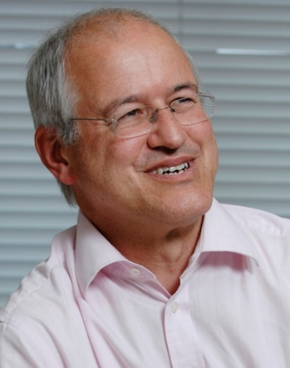
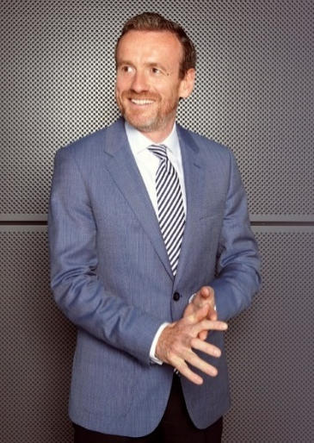

Review Panel
  Professor Mike Benton Professor of Vertebrate Palaeontology, Bristol University
  Professor Simon Gaskell President and Principal, Queen Mary University of London
  Axel Ruger Director, Van Gogh Museum
  Kathleen Soriano independent curator, writer and broadcaster.

Slide 7
Timeframe for review
Action | Date
TOR consultation with sector | May/June 2016
Share draft guidance | 20 June 2016
Town meeting | 30 June 2016
Publish final guidance | beginning of July
Submission deadline | noon 5 August 2016
Review phase | August/September 2016
Initial feedback | September 2016
Funding outcomes | Spring 2017

Slide 8
Submissions
  Throughout the submissions the panel will be strongly influenced by concise and persuasive arguments, rather than extensive background information
Submission Section 1: Gateway criteria (two A4 pages)
Section 2: Quality criteria (eight A4 pages)
Section 3: Contextual data
Brief covering letter providing authorisation by the head of institution
Annex.

Slide 9
Gateway criteria
  Gateway criteria will apply and, if not satisfied, will prevent the HEMG from being considered for funding
  gateway criteria act as a threshold
  two page limit
  gateway evidence can be expanded in quality criteria

Slide 10
Gateway criteria
Any HEI will need to meet the following gateway criteria to be considered for funding. The HEMG on which the submission is based must:
  be a ‘university museum or gallery’ and have a substantial and long-term financial commitment to maintaining a collection
  HEMGs will not need to meet all criteria (listed in the Guidance for submissions document)
  meeting any one criterion would not be sufficient.

Slide 11
Gateway criteria
Any HEI will need to meet the following gateway criteria to be considered for funding. The HEMG on which the submission is based must:
  incur significant reach beyond the HEI’s own researchers and students and as far as possible demonstrate the additional costs associated with this (200-word summary)
  evidence of the gain to the HE sector, and that costs are sufficiently significant to warrant additional funding
  a best estimate of the costs incurred.

Slide 12
Gateway criteria
Any HEI will need to meet the following gateway criteria to be considered for funding. The HEMG on which the submission is based must:
  make, or have the potential to make, a unique and significant contribution to research and scholarship in the HE sector (200-word summary)
  existing public documents and research outputs
  extracts of existing forward plans.

Slide 13
Gateway criteria
Any HEI will need to meet the following gateway criteria to be considered for funding. The HEMG on which the submission is based must:
  be operated in an efficient manner and demonstrate financial sustainability
  evidence of financial sustainability and solvency
  management accounts, or equivalent final income and headline expenditure for the last one to three years.

Slide 14
Gateway criteria
Any HEI will need to meet the following gateway criteria to be considered for funding. The HEMG on which the submission is based must:
  where eligible, hold Arts Council Accreditation status, or provide confirmation that it is working towards Accreditation status
  eligible: will need to strictly adhere
  ineligible: the spirit of the accreditation should be evidenced in terms of equivalent good practice and standards.

Slide 15
Gateway criteria
  Any questions?

Slide 16
Quality criteria
  promote excellence in research and scholarship
  consider submissions in their own institutional context
  evidence of past performance, potential for future performance and plans to deliver outcomes
  eight page limit

Slide 17
Quality criteria
  how far the HEMG is providing a service to the wider research community at significant cost beyond that required to meet the needs of its own researchers and students (beyond the normal degree of reciprocity in sharing research resources), highlighting the value added by the collection
Evidence may include, but is not limited to:
  evidence of the gain to the HE sector to warrant additional funding
  costs incurred to provide a wider service
  evidence of stewardship and management costs.

Slide 18
Quality criteria
  evidence that use of the HEMG has led to unique and significant contributions to research, scholarship and research impact in the UK and internationally
  Evidence may include, but is not limited to:
  extract(s) from existing public documents and forward plans
  references to internationally excellent outputs
  REF impact case studies
  Arts Council Designation status, or spirit of this status

Slide 19
Quality criteria
  the extent to which the HEMG is considered to offer unique and significant value to undergraduate and postgraduate students and the wider community, including the HEMGs approach to public engagement
  Evidence may include, but is not limited to:
  information about wider engagement activities and impact
  visitor numbers
  relationships with relevant stakeholder groups
  existing policies relating to the value offered to undergraduate and postgraduate students and the wider community.

Slide 20
Quality criteria
  the innovative practice employed by the HEMG for external benefit and in support of the open research agenda
Evidence may include, but is not limited to:
  use of digital technologies and/or crowdsourcing to enhance access
  innovative and influential partnerships and collaborations
  development of research skills and training for aspiring academics, including early career researchers and postgraduate students
  integration between academic study and material culture.

Slide 21
Quality criteria
  whether HEFCE HEMG funding is an appropriate proportion of the total cost of sustaining the museum or gallery, demonstrating additionality, and not core funding
Evidence may include, but is not limited to:
  draw on the information provided at gateway criteria ‘b’ and ‘c’ and quality criteria ‘a’
  information about existing core funding streams and leverage capabilities
  submissions should explain the level of HEMG funding sought.

Slide 22
Quality criteria
  Any questions?

Slide 23
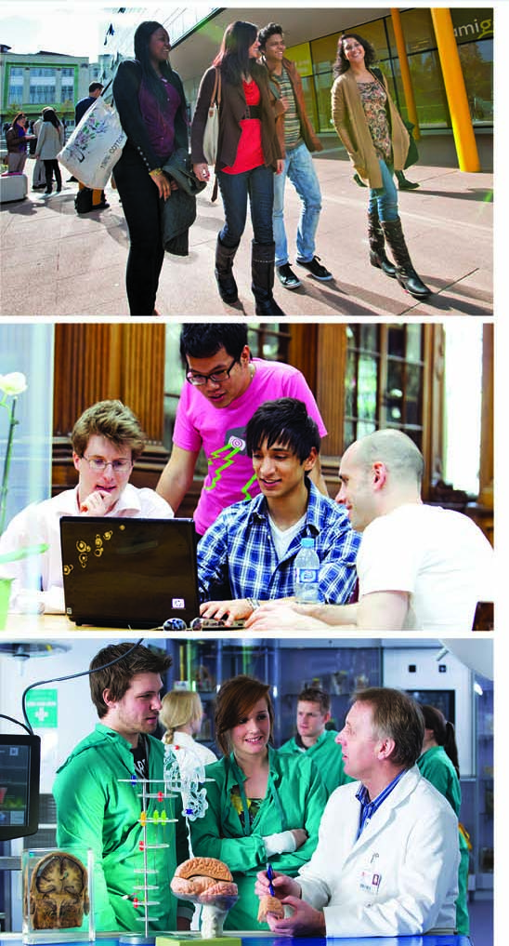
How to find out more
researchpolicy@hefce.ac.uk
www.hefce.ac.uk/rsrch/infrastructure/museums/

